Slide 1


Epistasis Analysis of microRNAs in Colon Cancer Using Empirical Bayesian Elastic Nets
Jia Wen, Andrew Quitadamo, Benika Hall and Xinghua Shi
Department of Bioinformatics and Genomics
University of North Carolina at Charlotte
Charlotte, North Carolina, United States.
http://shilab.uncc.edu

Slide 2
Outline
MicroRNAs (MiRNAs) and Colon Cancer
Questions and Challenges
How do microRNAs affect the pathological stages of colon cancer, both independently and in epistasis?
Our Pipeline Based on Empirical Bayesian Elastic Nets
Results
Main effect
Epistasis
Disease association
Gene ontology
Conclusion and Future Work

Slide 3
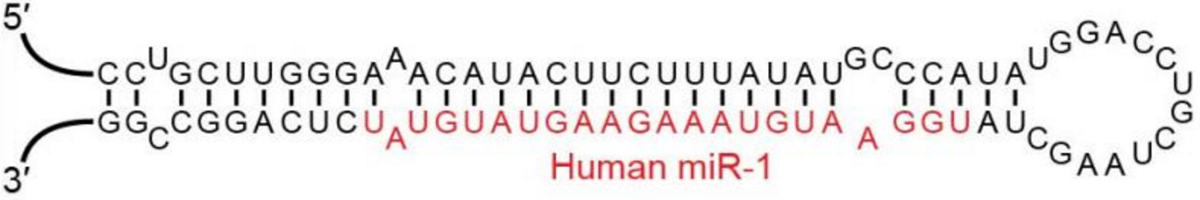
MiRNAs and Colon Cancer
Colon cancer is the second leading cause of cancer-related death in the United States and Europe, and it’s the third most common cancer among males and females around the world.
MiRNAs are small noncoding RNAs (18 to 24 nucleotides long).
MiRNAs regulate many genes post-translationally.
The aberrant expression of microRNAs in colon cancer can induce tumor development.
MiRNAs can serve as targets for tumor treatment and subtyping.

Slide 4
Questions?
Epistasis, defined here as the interactions that can be explained by a combination of two (epi-)genetic components, is an important component in cancer research and drug resistance research.
How do the miRNAs affect the pathological stages of colon cancer both independently (main effect) and in epistasis (epistatic effect)?

Slide 5
Challenges
How to deal with the high dimensional nature (n < p) of genomic and epigenomic data using parameter estimate methods?
How to efficiently find epistasis where strong main effects could and thus mask weaker epistatic effects?

Slide 6
Ideas
Due to the high dimension of genomic and epigenomic data, it’s difficult to deal with epistatic interactions using general parameter estimate methods.
In this study, we use an empirical Bayesian elastic net (EBEN) method (Huang et al, 2015), which is scalable to deal with high dimensional data as a feature selection model.
We develop a four-step workflow to identify main effect of miRNAs on pathological stages of colon cancer, eliminate main effect from the phenotype, use residual phenotype for epistasis analysis, and finally run a full model on features previously selected as main and epistatic features.
We used miRNA-target gene interactions and epistatic miRNA interactions to construct a miRNA-gene network.
Huang, A., et al.: Empirical Bayesian elastic net for multiple quantitative trait locus mapping. Heredity,2015, 114(1), 107-115

Slide 7

Data
Use the colon cancer data from The Cancer Genome Atlas (TCGA).
According to TCGA definition, pathological stage (tumor stage) refers that “classification assigned to a malignancy which allows for the grouping of similar cancer types based on the extent of disease in the primary tumor (T), regional lymph nodes (N), and metastatic sites (M), using criteria from the American Joint Committee on Cancer, or AJCC, staging criteria”.
Data pre-processing:
233 samples remained after excluding missing values in the pathological stage.
Filtered the miRNA read counts to remove miRNAs with more than 20% zeros, which left 376 miRNAs.
Normalized based on each miRNA vector using inverse quantile normalization.
Transformed the pathological stages into natural log value.
The Cancer Genome Atlas Dictionary
https://tcga-data.nci.nih.gov/docs/dictionary/
Notes:
XS:Explain pathological stages and their meanings

Slide 8
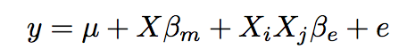
Methods
Statistical Model:
Existing methods:
General parameter estimate methods, LASSO, empirical Bayesian method, et al.
Combinatorial partitioning method (CPM) was developed for multi-locus-epistasis
Multifactor-dimensionality reduction method (MDR) was developed based on CPM.
Detecting genome-wide Association on Multiple diseases (DAM) which used Bayesian inference to infer multi-locus epistasis.
Multi-SNP Combination Set Detector (MSCD) to infer multi-SNP interaction
Epistasis Detector based on the Clustering of relatively Frequent items (EDCF)
GEM model to detect the functional epistasis
Huang, A., et al.: eQTL Epistasis – Challenges and Computational Approaches. Front Genet. 2013, 4: 51
Kang et al.: eQTL epistasis: detecting epistatic effects and inferring hierarchical relationships of genes in biological pathway. Bioinformatics, 2015, 31(5): 656-664.
Notes:
XS: Why we use EBEN instead of using these methods?
1. Due to the speed and high FDR, LASSO and EB are suit for high-dimension data. CPM, MDR, DAM and MSCD, and EDCF are designed for multi-locus epistatic interactions. GEM is developed for functional epistasis, while our study intended to detected the statistical pair-wise epistasis.
2. In other aspect, EBEN used two-level prior distribution for unknown parameters and a coordinate ascent method so that can quickly estimate the pair-wise epistatic interactions among features, even though the dimension of data is high. The statistical techniques in EBEN are shrink operator and variable selection.
3. At last, EBEN also gave non-zero coefficients with estimating the covariances and could do the t-test through covariances to obtain the p-value from point estimate.

Slide 9
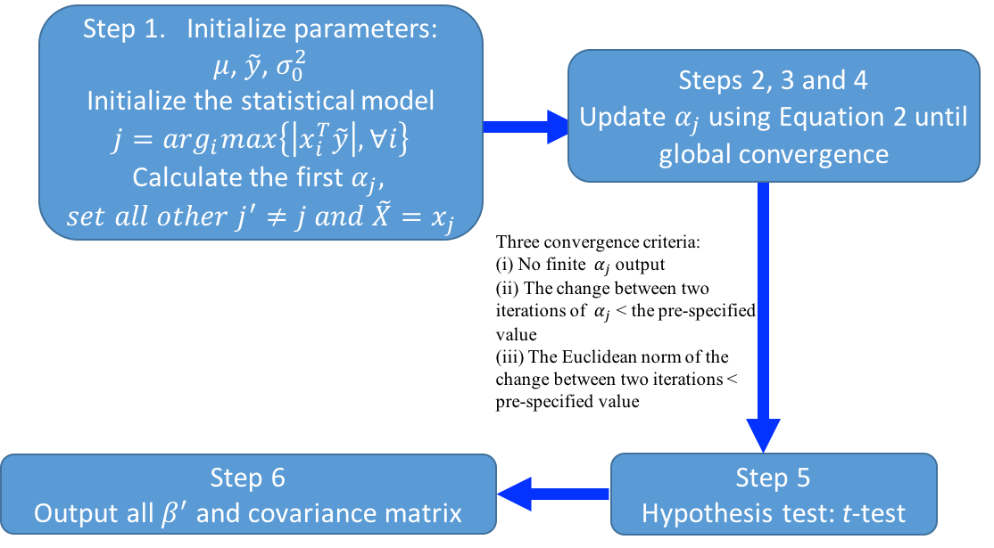
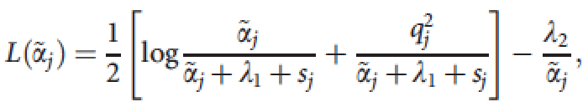
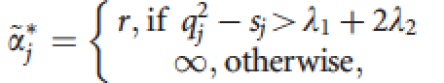
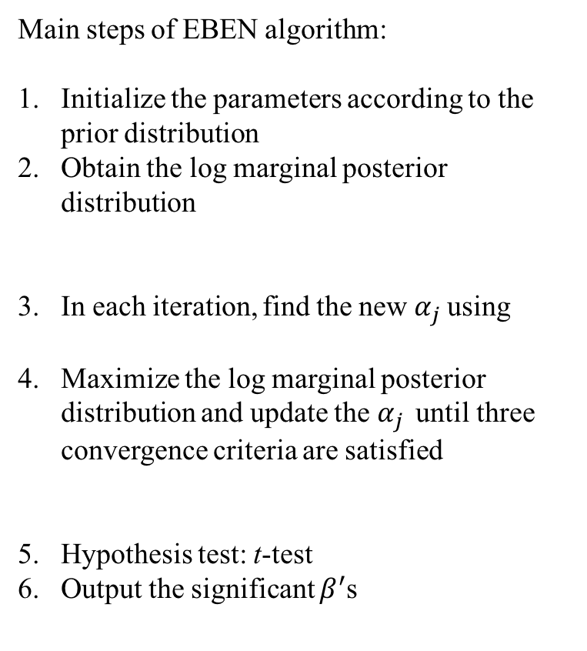
The method used in our study
Main steps of EBEN algorithm:
Initialize the parameters according to the prior distribution
Obtain the log marginal posterior distribution
In each iteration, find the new${ α}_{j}$ using
Maximize the log marginal posterior distribution and update the${ α}_{j}$ until three convergence criteria are satisfied
Hypothesis test: t-test
Output the significant $β^{′}$s
(1)
(2)
(3)
Huang, A., et al.: Empirical Bayesian elastic net for multiple quantitative trait locus mapping. Heredity,2015, 114(1), 107-115
Notes:
Typos! Can you change the text to text boxes so I can edit? Should be alpha_j instead the arrow?

Slide 10
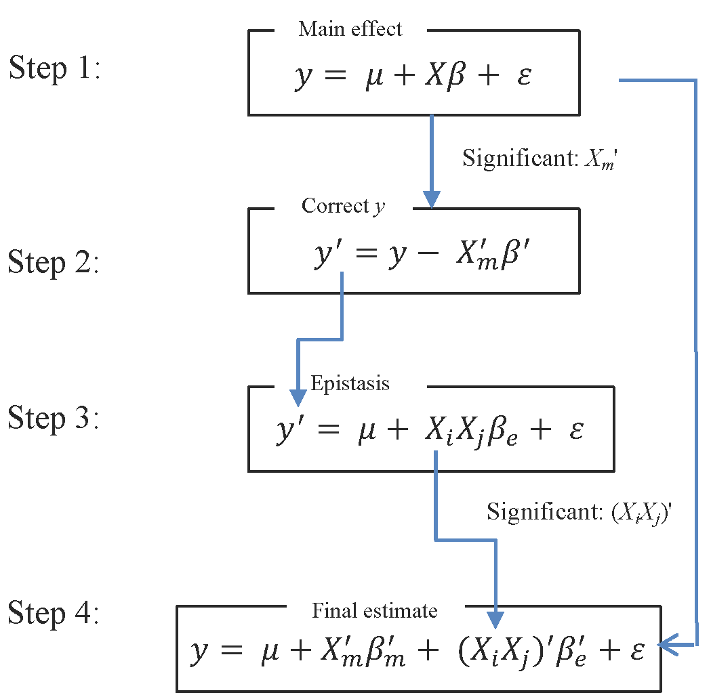
Workflow
Procedure to estimate parameters
Step 1: We ran an EBEN model including solely main effect Xβ_{m}. Only these significant features would be included in the main effect part of the model of Step 4 (P < 0.05).
Step 2: Then we eliminated these main effects from the original phenotype y, the natural log value of pathological stage in our study, to generate the corrected y’ after removing main effects.
Step 3: The corrected y’ was used as the new dependent variable to detect epistasis using EBEN (P < 0.05). Only these significant features pairs would be included in the epistatic term of the model of Step4.
Step 4: All the features with significant main effects from the step 1 and epistatic features identified in Step 3 were included in the equation and estimated by EBEN (P < 0.05). The finally selected features with main effect and epsitatic effect were reported as final results.
Notes:
XS: Check if my edits are correct. Yes, you are correct.
Set initial random seed and 5-fold cross validation to improve the precision and accuracy.

Slide 11
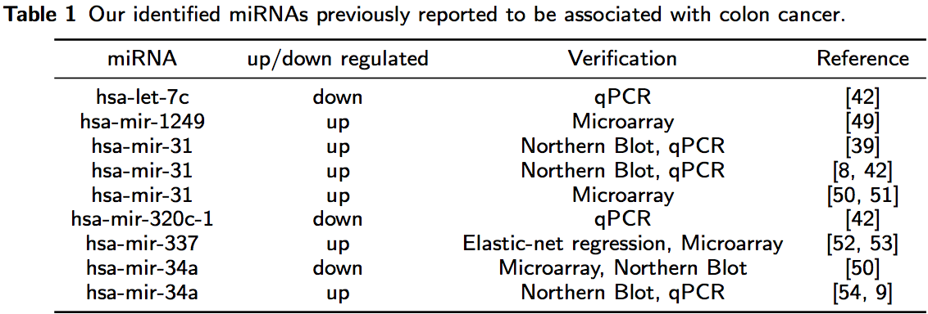
Main Effect miRNAs
In total, 11 miRNAs with main effect on pathological stage are detected. Among them, 6 miRNAs have been reported in previous experimental studies to be up/down-regulated in colon cancer.
Notes:
Table 1 showed the summary of main effect miRNAs verified by another experimental researches in our result.

Slide 12
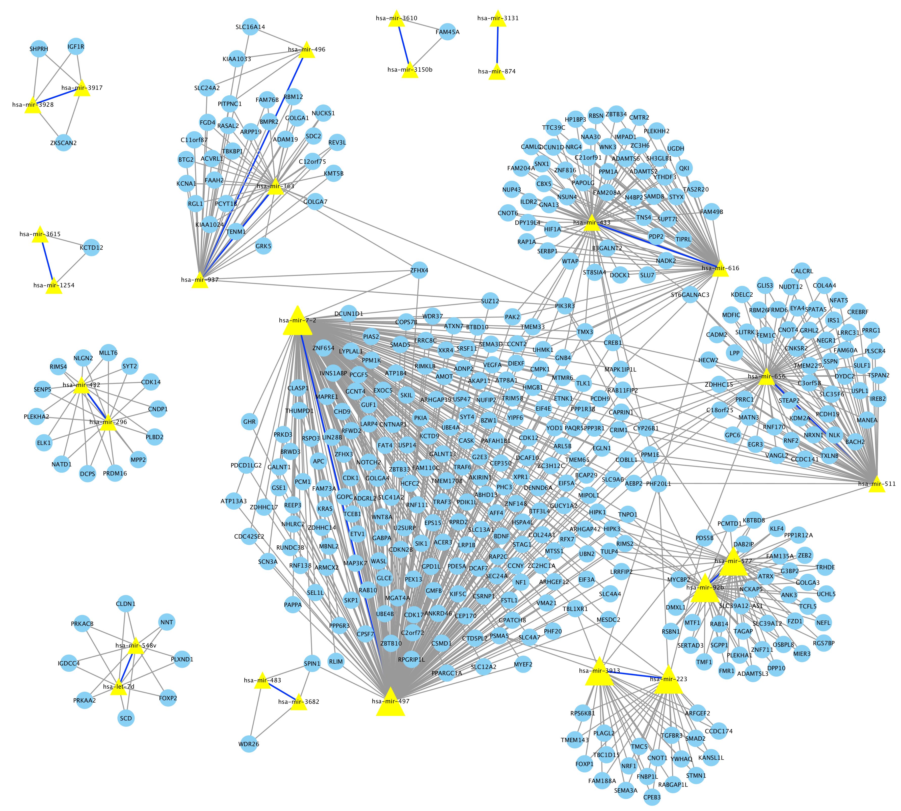
Epistatic miRNAs and Target Genes
Epistasis
Among the 14 epistatic miRNA pairs detected in our study, 13 pairs have common target genes in miRNA target databases including miR2Disease, TargetScan and miRDB.
Example:
Epistatic hsa-mir-497 and hsa-mir-7-2 shared 2 common target genes APC and KRAS. These two target genes are in the Wnt signaling pathway, which was implicated in the development of colon cancer.
Notes:
XS: where are these examples, using a box to highlight

Slide 13
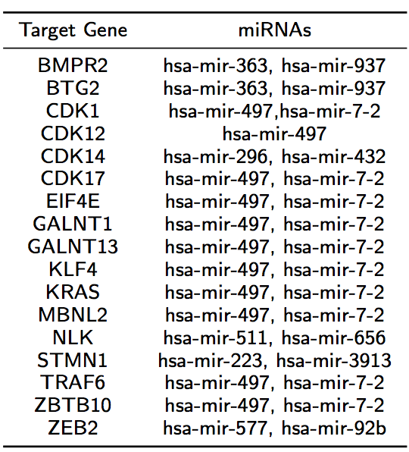
Epistatic miRNAs and Target Genes
Among all epistatic miRNAs, 17 common target genes that were shared among miR2Disease, TargetScan and miRDB. (XS: what does this mean?)
10 target genes shared one miRNA hsa-mir-497, Among the 10 target genes, EIF4E, KLF4 and KRAS related to colon cancer.
And hsa-mir497 has been identified to have lower expression levels and be directly related to progression in colorectal cancer in more recent studies. (Any of these 10 target genes related to colon cancer? TRAF6 is a cancer gene, right?)
Notes:
XS, how many epistatic miRNAs in total (14 pairs)? Yes.
1. 17 common target genes that were shared among miR2Disease, TargetScan and miRDB. (XS: what does this mean?)
Among all target genes of epistatic miRNAs, 17 target genes are common among three databases.
2. Any of these 10 target genes related to colon cancer? TRAF6 is a cancer gene, right?
Not correct, it just described the Table 3 result. Among the 10 target genes, EIF4E, KLF4 and KRAS related to colon cancer. In more recent studies, hsa-mir497 has been identified to have lower expression levels and be directly related to progression in colorectal cancer\cite{aherne2015circulating}

Slide 14
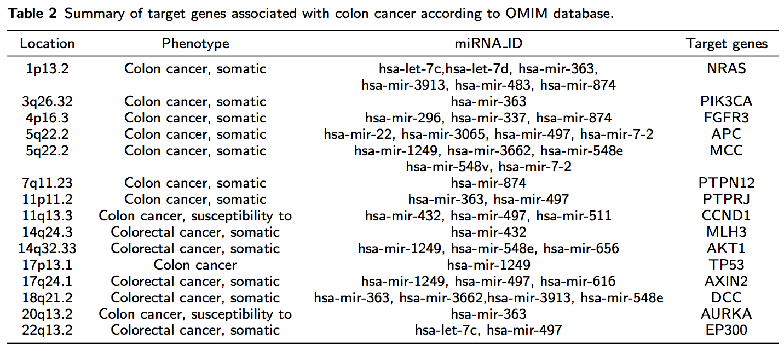
Target Genes (Main & Epistatic miRNAs)
Disease associations
The Online Mendelian Inheritance in Man (OMIM) Disease database reported 15 target genes (of total how many target genes?8725) of miRNAs with main and epistatic effect on pathological stages, were associated with colon cancer.
Notes:
(of total how many target genes?)
From three databases, we had 8725 target genes of miRNAs with main and epistatic effect.

Slide 15
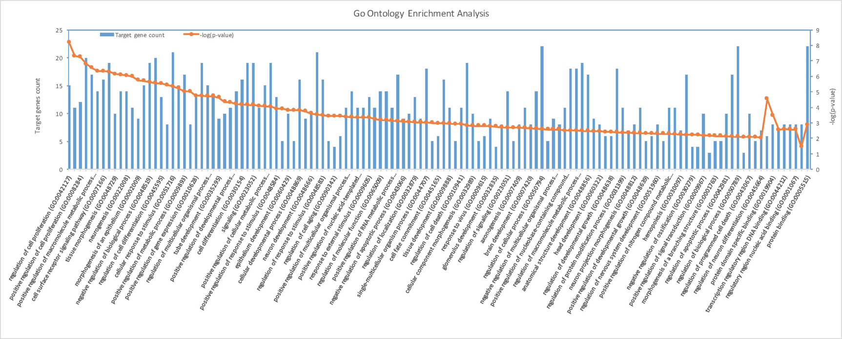
GO Enrichment Analysis
Gene Ontology
Biological process
Molecular function
Carbon S, Ireland A, Mungall CJ, Shu S, Marshall B, Lewis S, AmiGO Hub, Web Presence Working Group. AmiGO: online access to ontology and annotation data. Bioinformatics. Jan 2009;25(2):288-9.
Notes:
From the experimental database of miR2Disease, we conducted the functional annotation using Go database which gave us good results. These well-annotated results mainly belong to main categories, biological process and molecular function.

Slide 16
Conclusions
We developed a workflow that incorporates models for studying the main effect and pair-wise epistasis analysis.
A new method, empirical Bayesian elastic net method (EBEN), was used to solve this model, which has been demonstrated to efficiently select significant features in (epi-)genomic datasets.
We used miRNA expression data and pathological stages in colon cancer, however, this workflow can be used to identify epistasis in any disease/complex trait with various types of (epi-)genomic data.
Our study provided a reference pipeline for epistasis analysis in future research of biomarker and drug discovery, as well as in prognosis prediction.

Slide 17
Future Work
Include genetic variation (e.g. SNPs) into our full model.
Apply to other datasets/cancers/phenotypes/etc.
Develop new method that could include the covariates into the full model.
Explore other epistatic models and compare with EBEN.

Slide 18






Acknowledgements
Shi Lab Members
Post-Doc
Jia Wen
PhD Students
Benika Hall
Andrew Quitadamo
PSM Students
Dahlia Shvets
Heena Desai
Sasan Najar
Lei Xu
Conor Nodzak
Undergraduate Students
Katherine Jensen (King-Wooten)

